Slide 1
Progress Presentation
Christine and Heidi

Slide 2
Research Question
At what age are dancers most vulnerable to injury?
When should injury prevention education begin for dancers?
Can we use age to predict sprain and/or fracture injuries?
What is the most common way dancers are being injured?

Slide 3
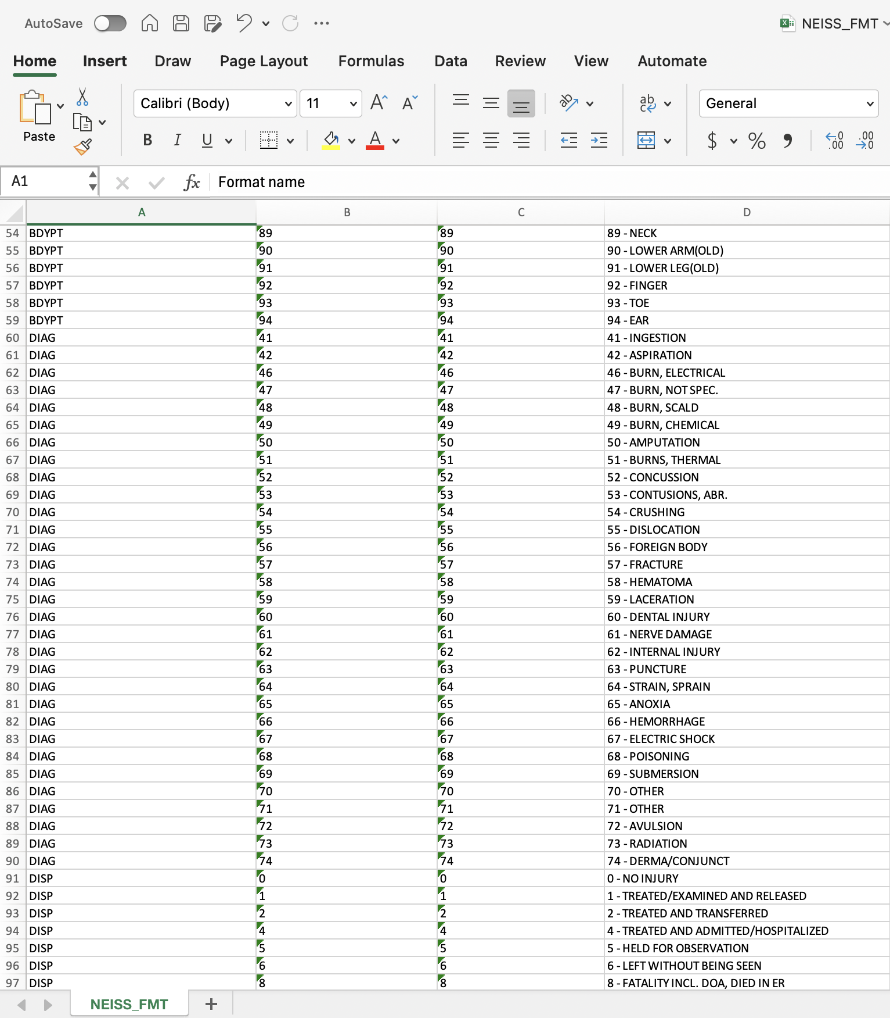
Data
NEISS Database
Submit a query for dance related injuries
Returned an excel sheet with requested data
Also returned an excel sheet that can be used as a key for the text data that was transformed into numerical data
I had 11 excel sheets; a yearly report on patients, and the key file
Notes:
National Electronic Injury Surveillance System

Slide 4
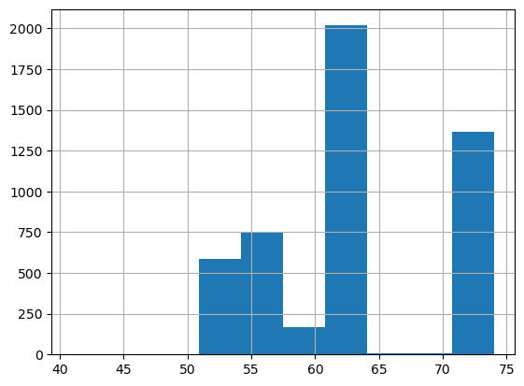
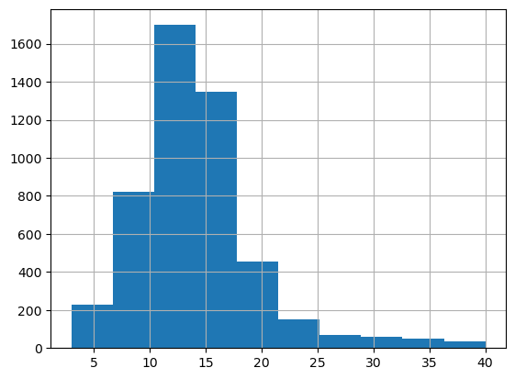
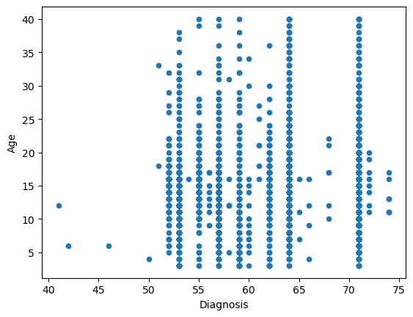
EDA
Diagnosis vs. Frequency
Age vs. Frequency
Diagnosis vs. Age
From the first histogram we can see that the most frequent diagnosis was a strain or sprain
From the second histogram we can see that the most frequent ages are between10-14 years old
There is not a clear pattern in the diagnosis vs. age graph
Notes:
Then looked at the distribution of a few columns

Slide 5
Implications for Stake-Holders
Dance Companies:
If dancers are experiencing career-ending injuries earlier on in their lives, or do not know how to properly care for their injuries, there will be less dancers able to provide long-term employment with dance companies, or the liability of their more-frequent injuries will fall on the dance company.
Dance Teams
You cannot have a successful dance team without uninjured dancers, if these injuries are more likely to happen when most dancers are on a dance team, this can impact the competitions and dance studios main source of funding.

Slide 6
Ethical Implications
Use of Medical Data
One ethical dilemma with using this data is the fact that it is medical data, although there are no identifying pieces of data, people may not like their data being put out in a public way like this.
Culture Shift
There is often a ‘dance through the pain’ culture in many studios, if there is a connection between age and injury prevention education this culture often toxic culture could be changed
Would this research be enough to get that change to happen?
Access
If a correlation was found, would all dance studios have access to this type of education?
Notes:
Knowing there is a solution but not being able to provide it could cause a lot of guilt

Slide 7
Where do we go next?
Classification models using age as a predictor, one predicting whether the dancer had a sprain injury and the other predicting if the dancer experienced a fracture injury
Random Forest Classifier
SVM Models
Text analysis on how the injuries occurred within the class
Latent Dirichlet Allocation, topic modeling

Slide 8
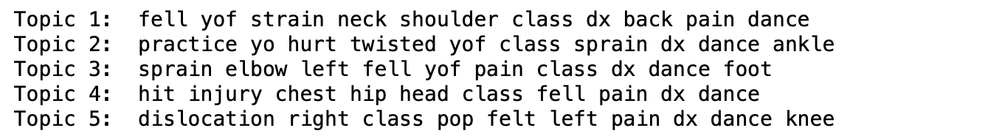
Model Progress
LDA:
Random Forest Classifier
We ran the model for predicting diagnosis using the other columns.
Since we haven't changed the diagnosis column to binary yet, it's not producing accurate results.
Random Forest Classifier, Decision Tree, and SVM

